Slide 1
Discriminative Sub-categorization
Minh Hoai Nguyen, Andrew Zisserman
University of Oxford
Notes:
et al: italic
Titles: should be capitals
Inconsitent use of periods. In prensentation, no periods.
Tile slide: put CMU

Slide 2

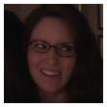

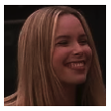
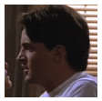
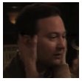
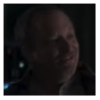
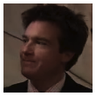
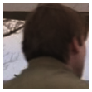
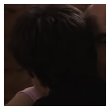
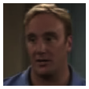
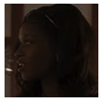
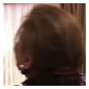
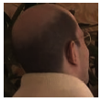
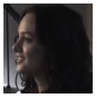
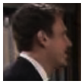
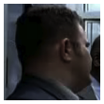
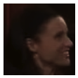
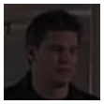
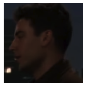
Sub-categorization
Head-images
Sub-category 1
Sub-category 2
Sub-category 3
Sub-category 4
Sub-category 5
Why sub-categorization?
- Better head detector
- Extra information (looking direction)

Slide 3
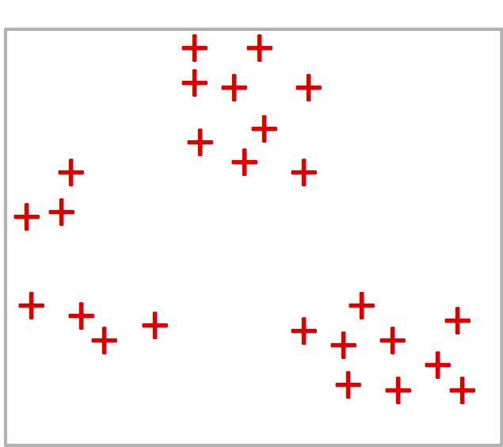
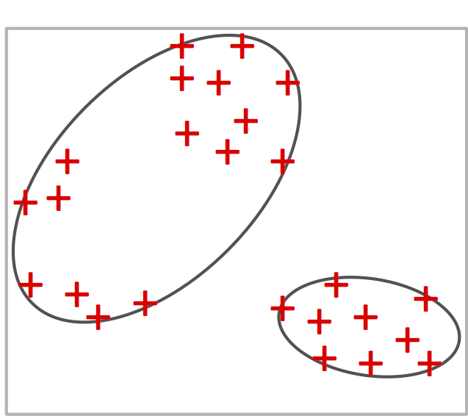
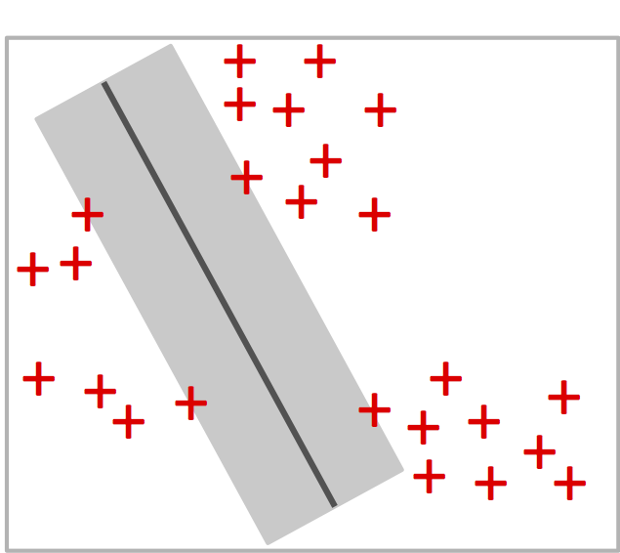
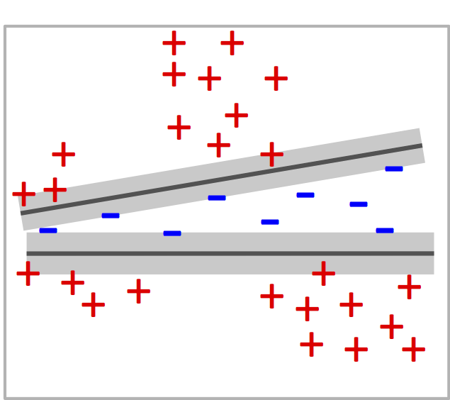
Sub-categorization with Clustering
Data from
a category
SVMs with latent variables (Latent SVM) (e.g., Andrews et al. ‘03, Felzenszwalb et al. ‘10)
Max-margin clustering
(e.g., Xu et al. ‘04, Hoai & De la Torre ‘12)
K-means clustering
Suitable for tasks requiring
separation between positive &
negative (e.g., detection)

Slide 4
Latent SVM
A latent variable
for positive sample
No latent variable
for negative sample
Objective:
+
+
Optimize SVM parameters
Determine latent variables
+
+
+
+
+
+
+
+
-
+
-
-
-
Iterative optimization, alternating:
+
-
-
-
-
-
Given and ,
+
+
+
+
+
+
+
+
update SVMs’ parameters
+
+
+
+
+
Given , update latent variables
Often leads to cluster degeneration:
a few clusters claim most data points

Slide 5
Cluster Degeneration
An explanation (not rigorous proof): the big gets bigger
Suppose Cluster 1 has many more members than Cluster 2
It is much harder to separate Cluster 1 from negative data
Cluster 1 has a much smaller margin
Big cluster will claim even more samples

Slide 6
Discriminative Sub-Categorization (DSC)
Change from the Latent SVM formulation:
+
Margin violation
k: # of clusters
n: # of positive samples
: cluster assignment
: SVM parameter
To this formulation (called DSC)
+
Margin violation
DSC is equivalent to
Coupled with latent variable
+
Margin violation
Proportion of samples in Cluster

Slide 7
Cluster Assignment
Change from Latent SVM formulation:
To DSC formulation
Similarity between DSC and K-means:

Slide 8
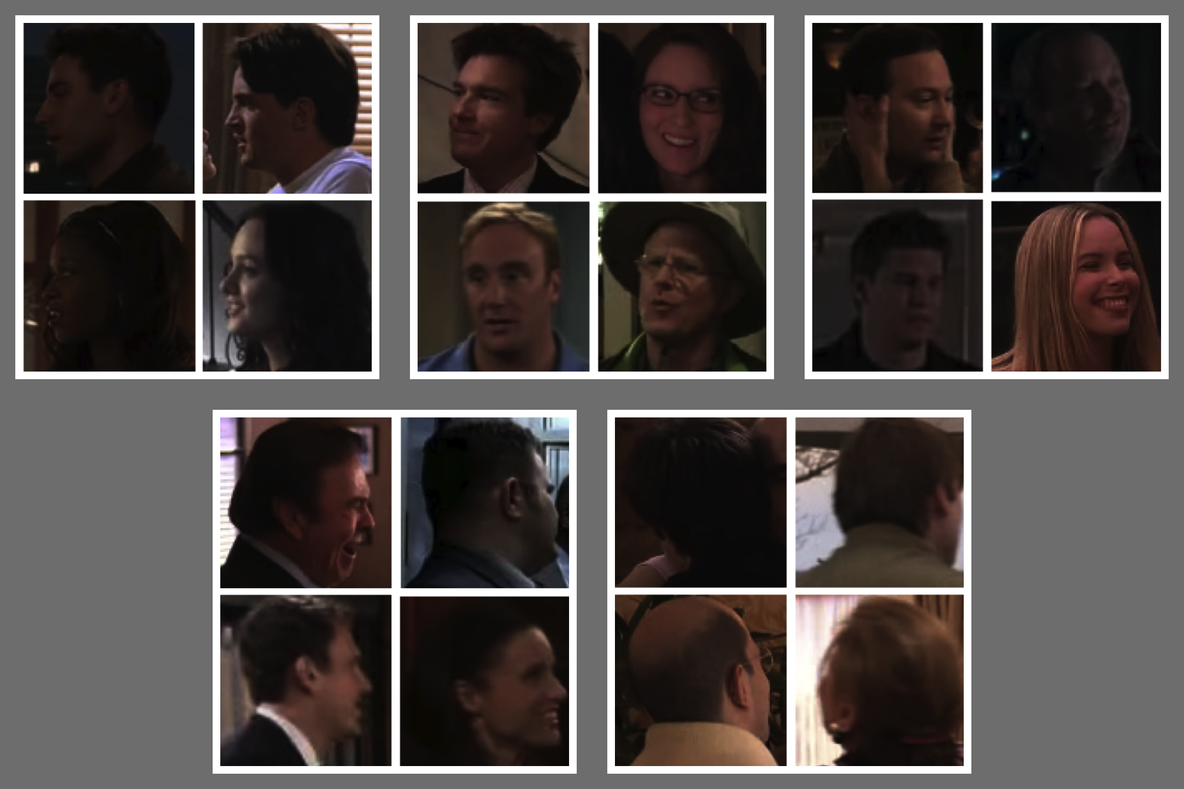
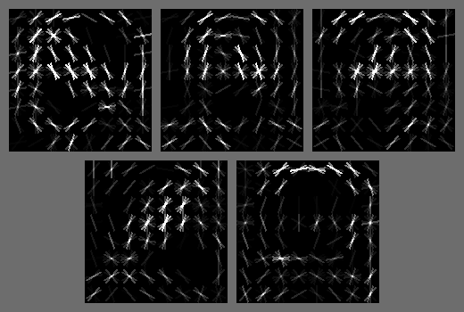
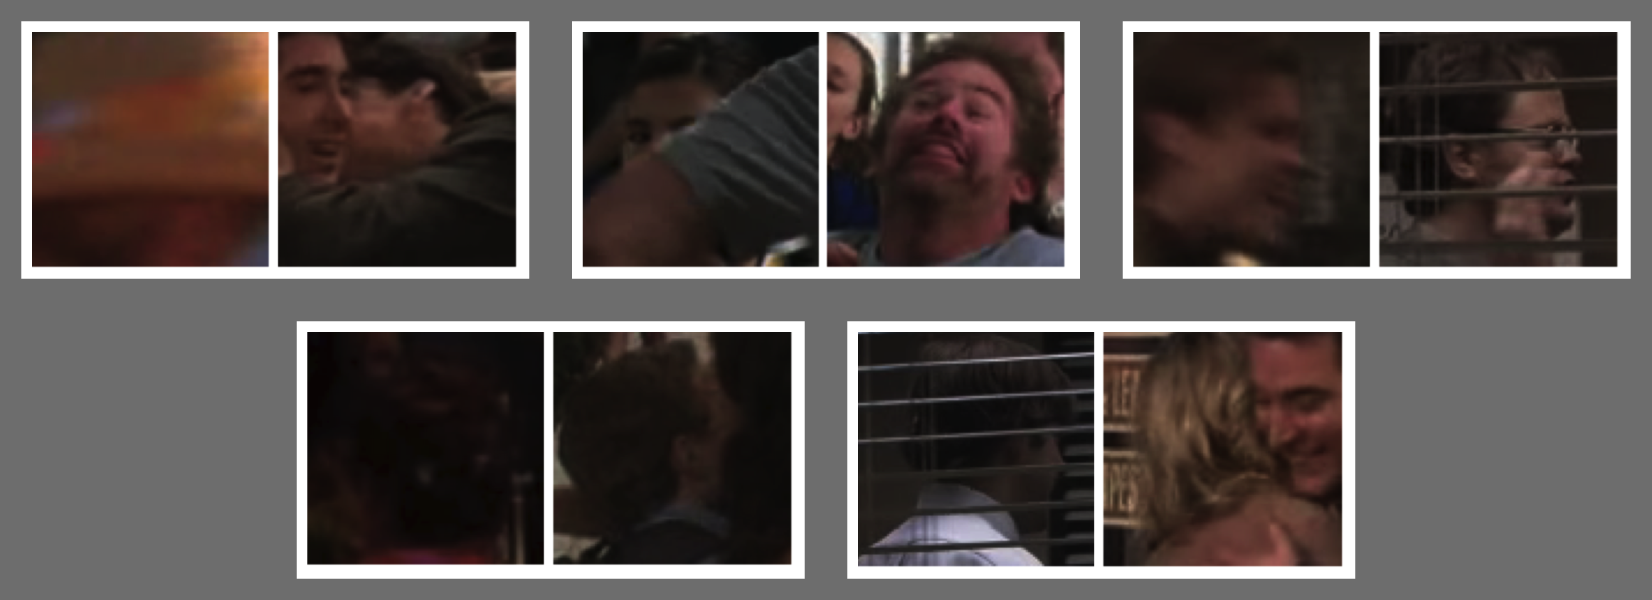
Experiment: Sub-categorization Result
Input images from TVHI dataset
High-score images
Output HOG weight vectors
Low-score images

Slide 9
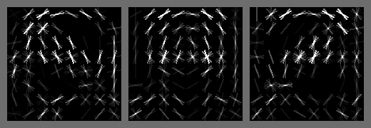
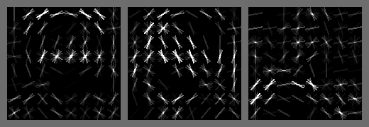
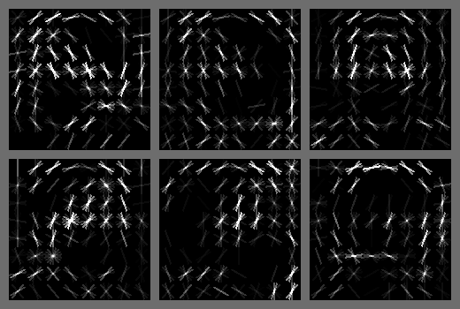
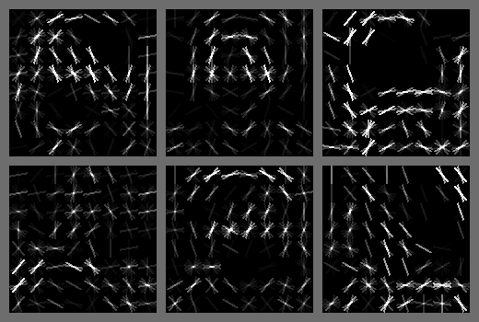
Experiment: DSC versus LSVM
DSC (ours)
Latent SVM
3 sub-categories
3 sub-categories
6 sub-categories
6 sub-categories

Slide 10
Experiment: DSC for Object Detection
- Train a DPM (Felzenszwalb et al.)
to detect upper bodies
Precision
Examples of Upper body
- Uses DSC for initialization
- Each sub-category is a component
Recall

Slide 11
Experiment: Comparison with k-means
- Train a DPM (Felzenszwalb et al.)
to detect upper bodies
Precision
Examples of Upper body
- Uses DSC for initialization
- Each sub-category is a component
Recall

Slide 12
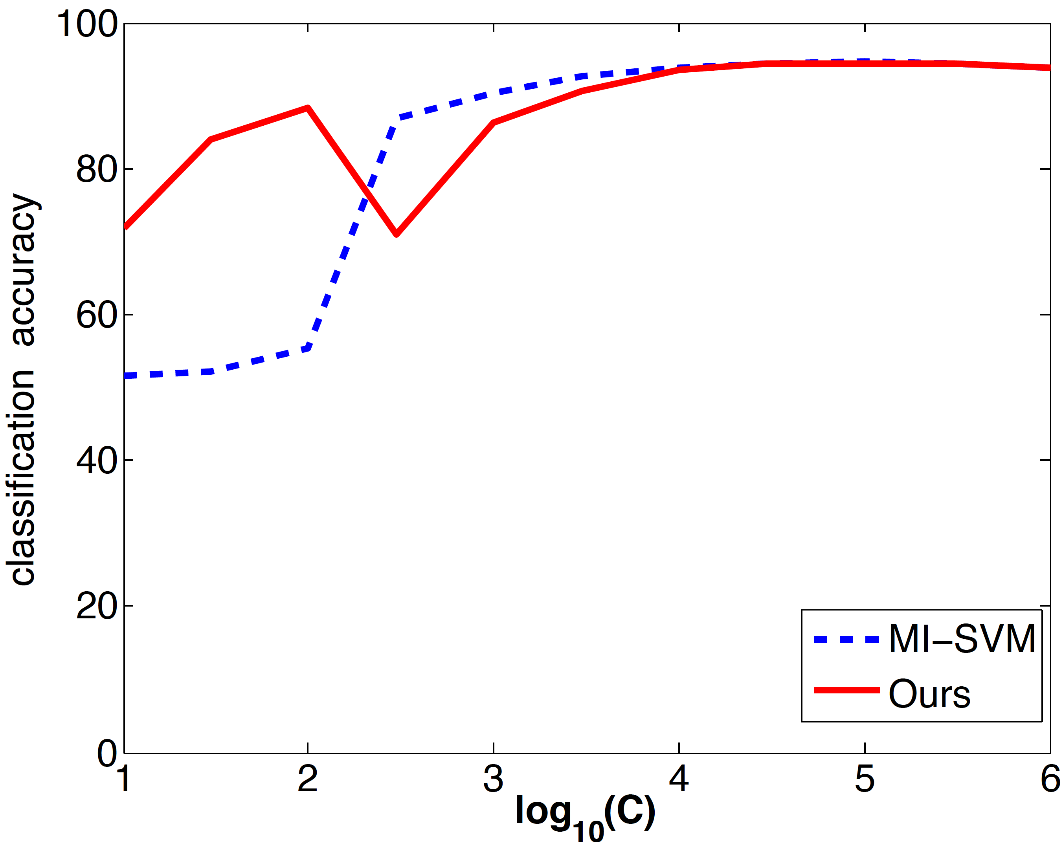
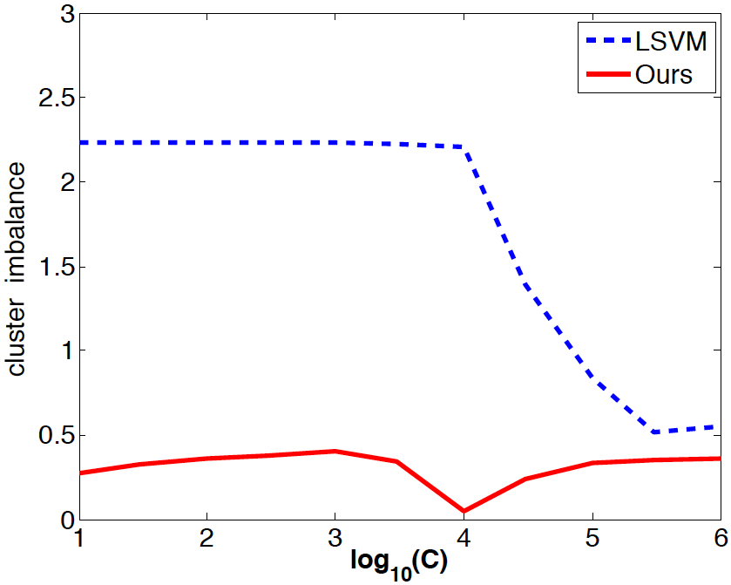
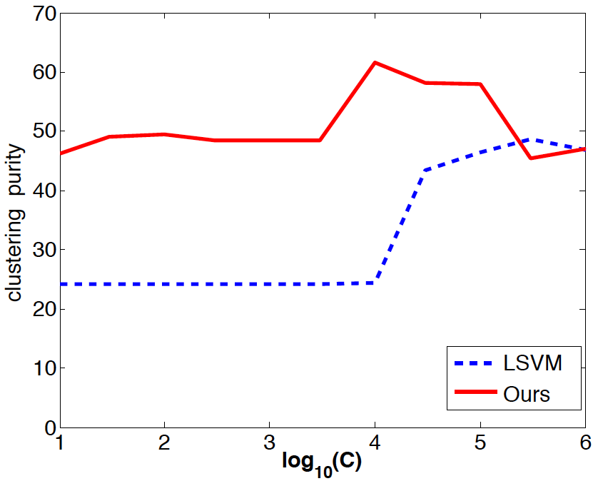
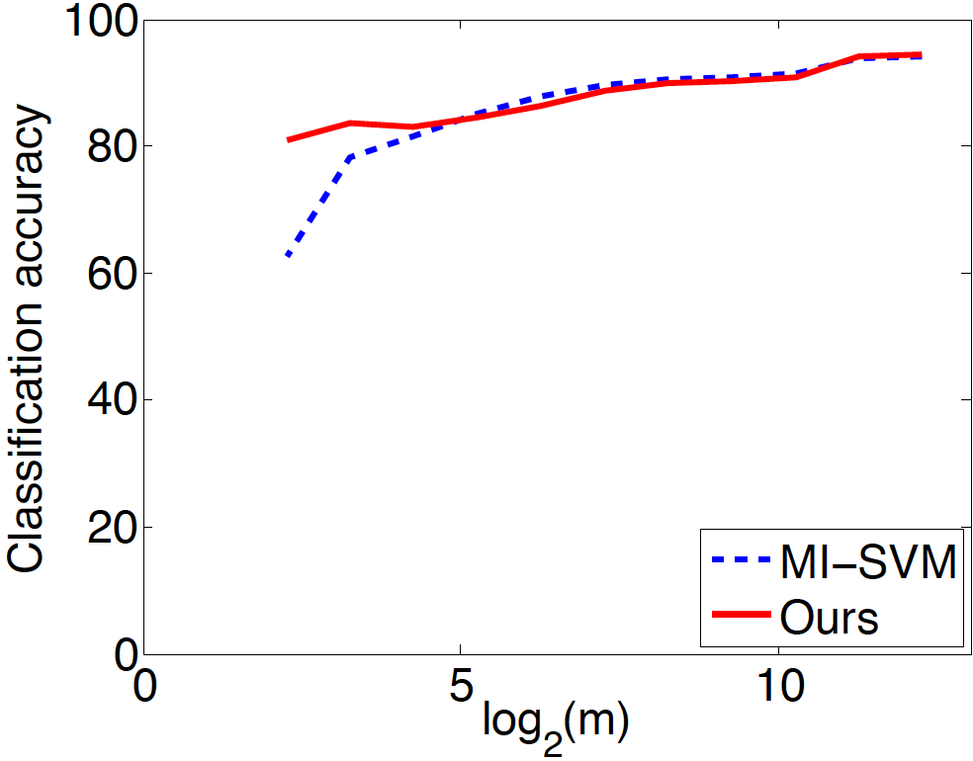
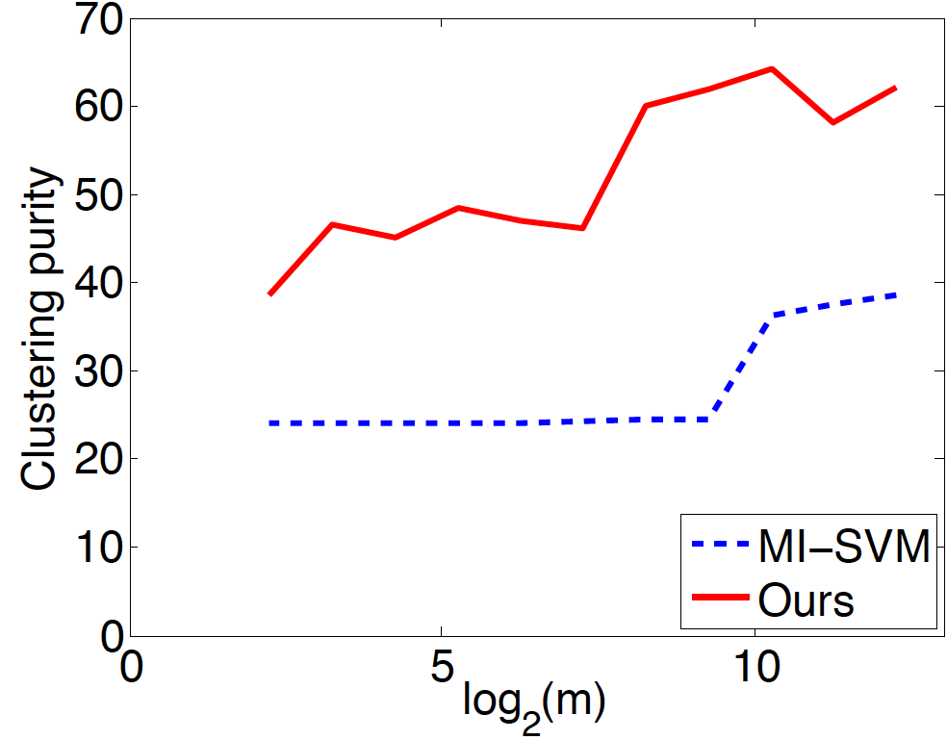
Experiment: Numerical Analysis
Vary C, the trade-off parameter for large margin and less constraint violation
Classification accuracy
Cluster Imbalance
Cluster Purity
Vary the amount of negative data

Slide 13
Experiment: Cluster Purity
Dataset | #classes | #features | #points | k-means | LSVM | DSC (ours)
Gas Sensor | 6 | 128 | 13910 | 46.38 ± 0.69 | 56.74 ± 1.88 | 60.82 ± 1.64
Landsat | 6 | 36 | 4435 | 78.72 ± 2.08 | 69.37 ± 2.32 | 76.73 ± 2.38
Segmentation | 7 | 19 | 2310 | 71.96 ± 1.75 | 65.89 ± 2.36 | 74.41 ± 1.85
Steel Plates | 7 | 27 | 1941 | 53.29 ± 1.51 | 52.64 ± 2.02 | 54.60 ± 1.98
Wine quality | 7 | 12 | 4898 | 43.43 ± 1.58 | 55.00 ± 2.35 | 54.21 ± 1.65
Digits | 10 | 64 | 5620 | 76.38 ± 1.72 | 77.83 ± 1.57 | 80.15 ± 1.18
Semeion | 10 | 256 | 1593 | 64.64 ± 1.20 | 64.32 ± 1.58 | 66.74 ± 1.43
MNIST | 10 | 784 | 60000 | 65.38 ± 1.43 | 63.99 ± 1.36 | 66.18 ± 1.34
Letter | 26 | 16 | 20000 | 33.35 ± 0.48 | 40.27 ± 0.88 | 44.38 ± 0.74
Isolet | 26 | 617 | 6238 | 62.15 ± 1.22 | 61.95 ± 1.22 | 64.08 ± 1.18
Amazon Reviews | 50 | 10000 | 1500 | 24.93 ± 0.32 | 24.89 ± 0.41 | 25.08 ± 0.38
Results within one standard error of the maximum value are printed in bold

Slide 14
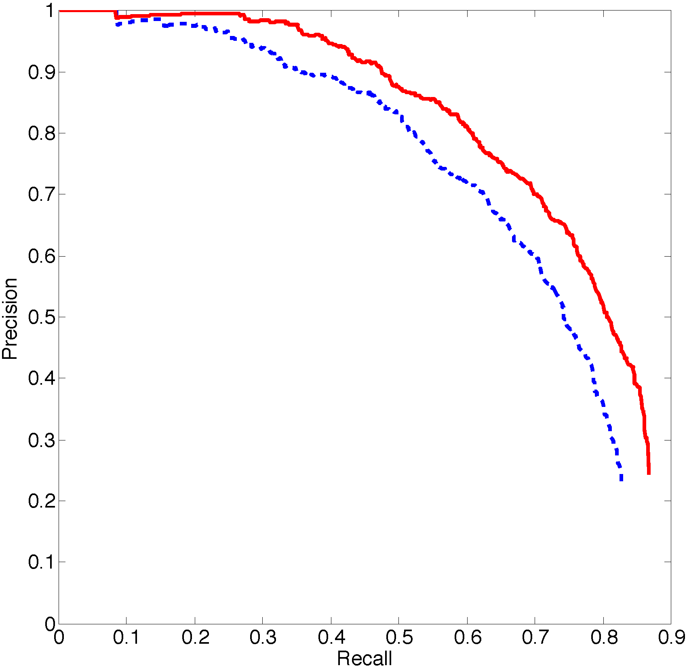
Summary
What the algorithm does:
Properties of the algorithm:
- Max-margin separation
from negative data
- Quadratic objective
with linear constraints
Input:
Benefits of the algorithm:
- Does not suffer from cluster degeneration
a few clusters claim most data points
- Visually interpretable
sub-categorize
- Useful for object detection using DPM of
Felzenszwalb et al.
Output:
With sub-categorization
Precision
Without sub-categorization
Recall

