Slide 1


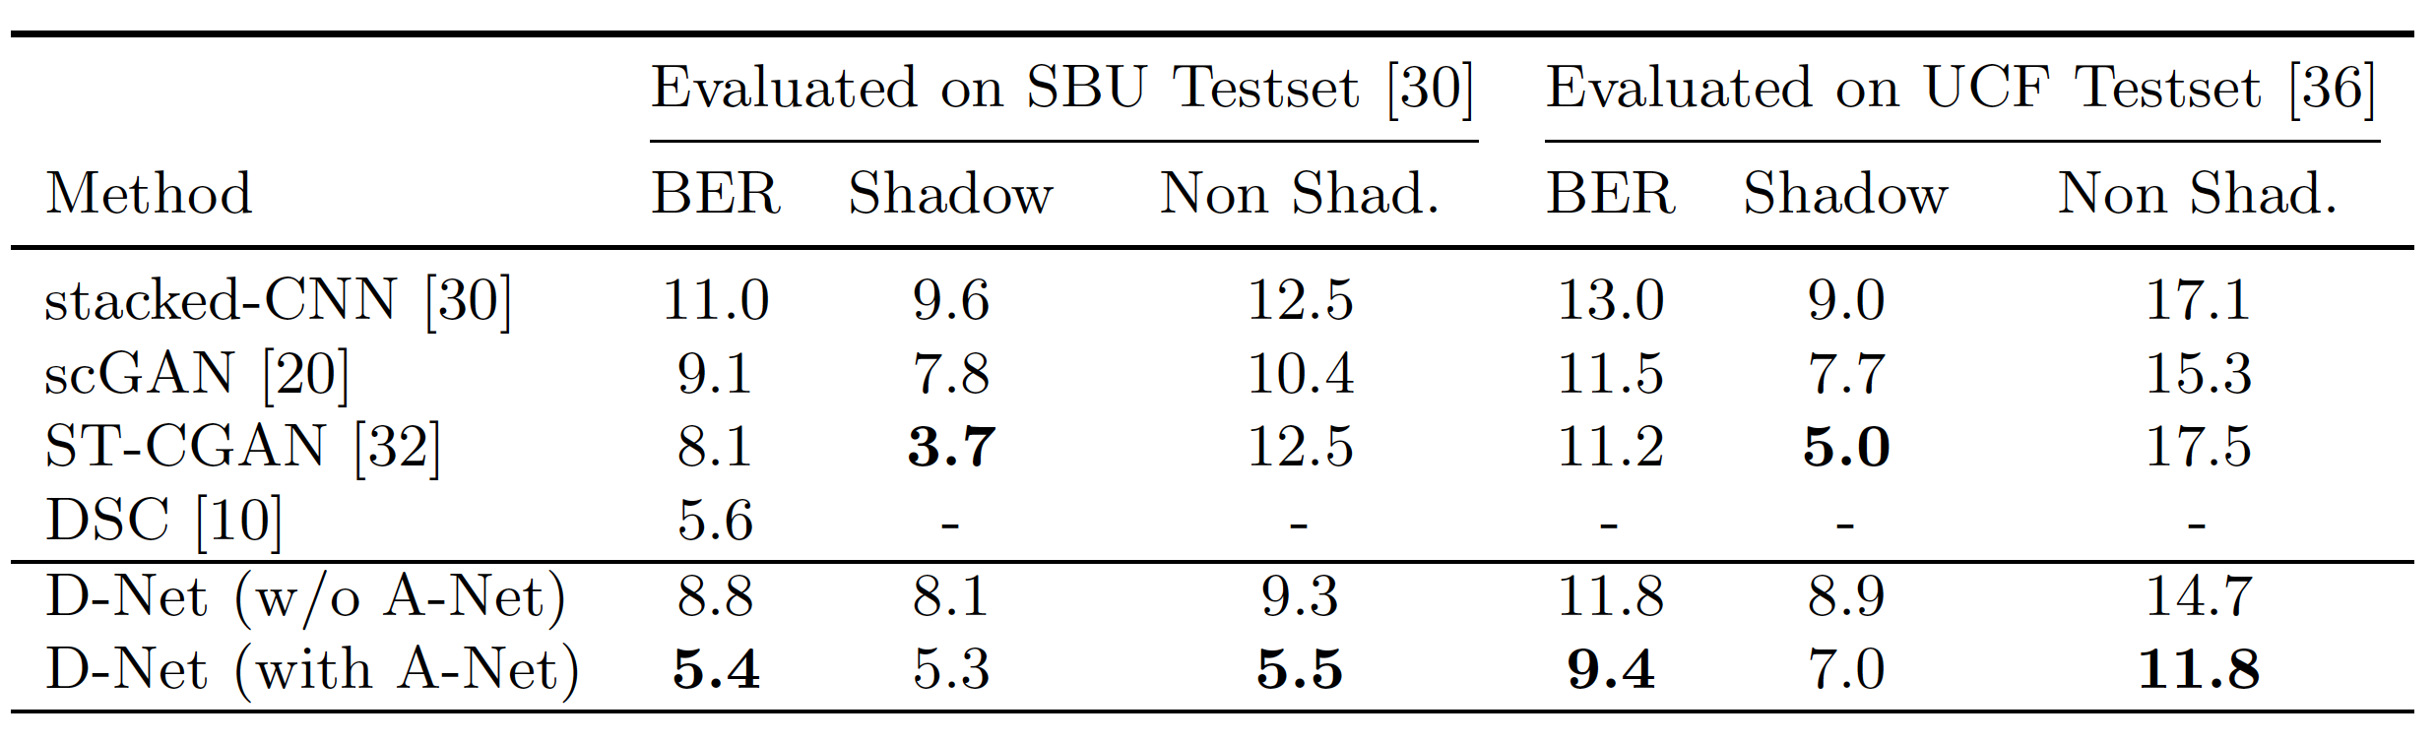
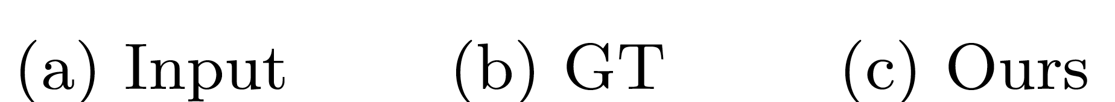
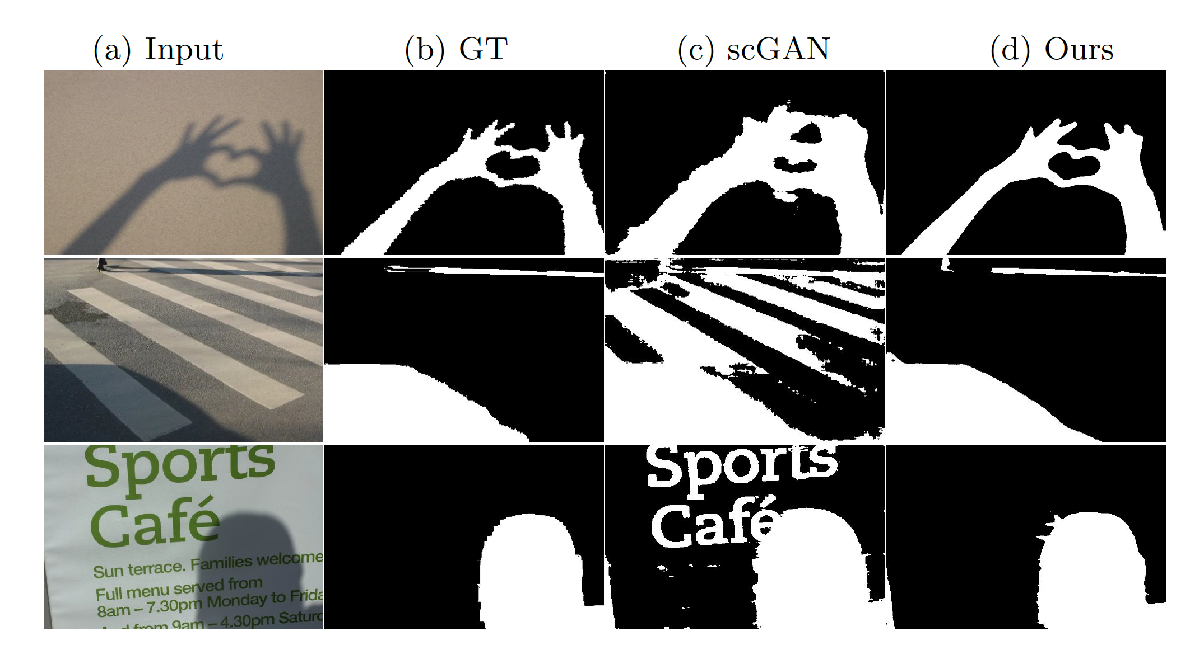
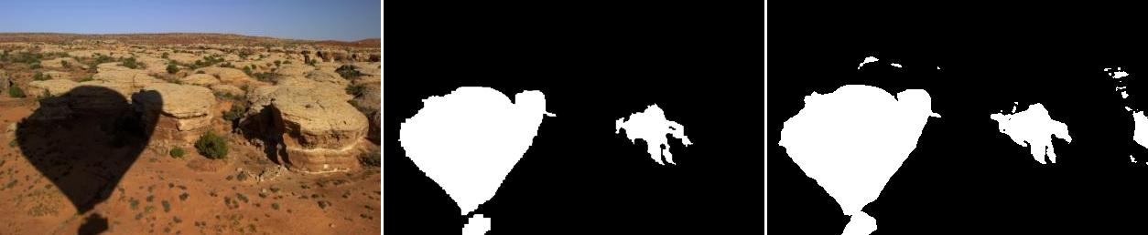
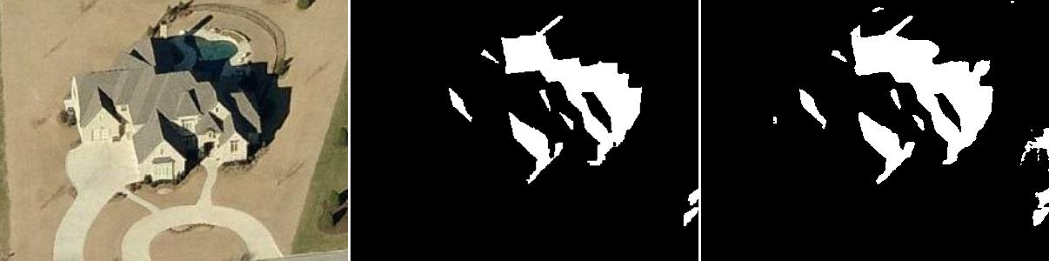
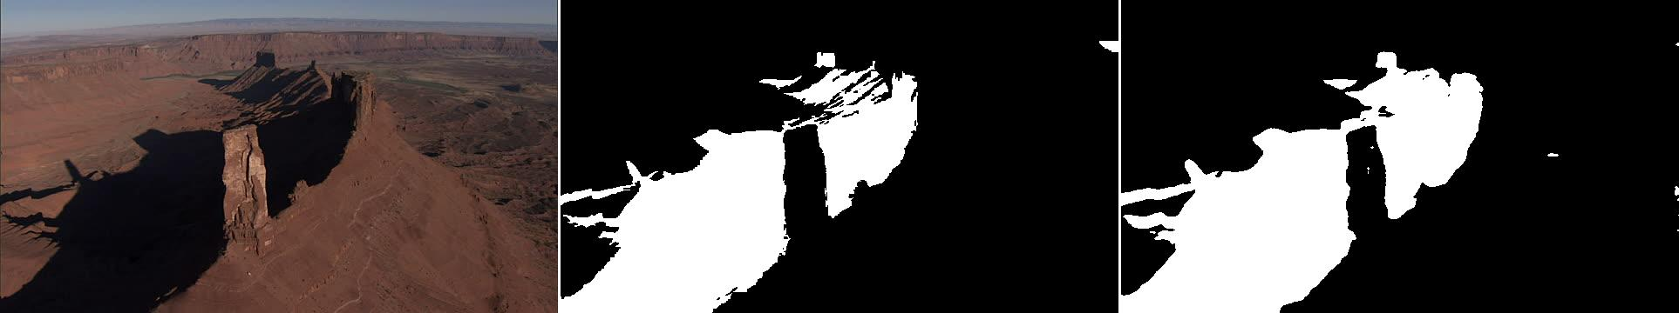
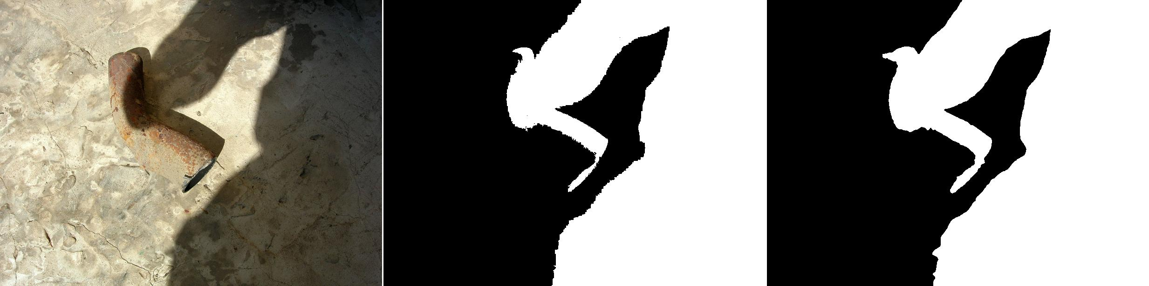
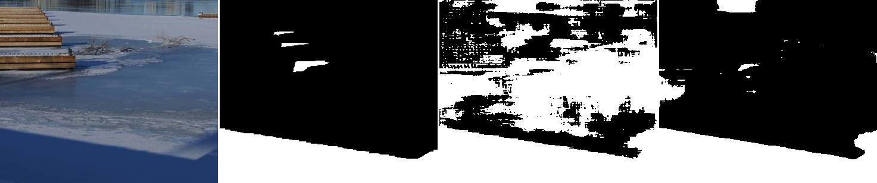
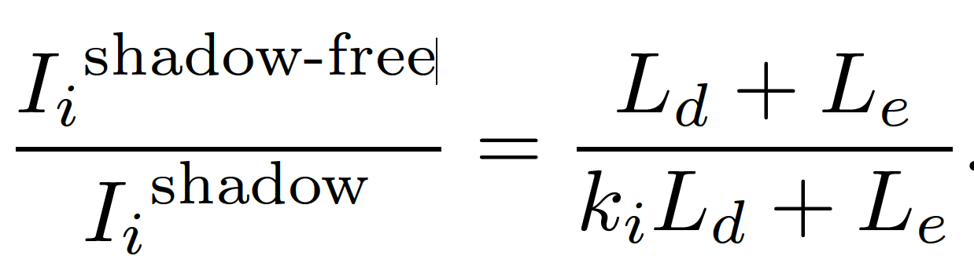
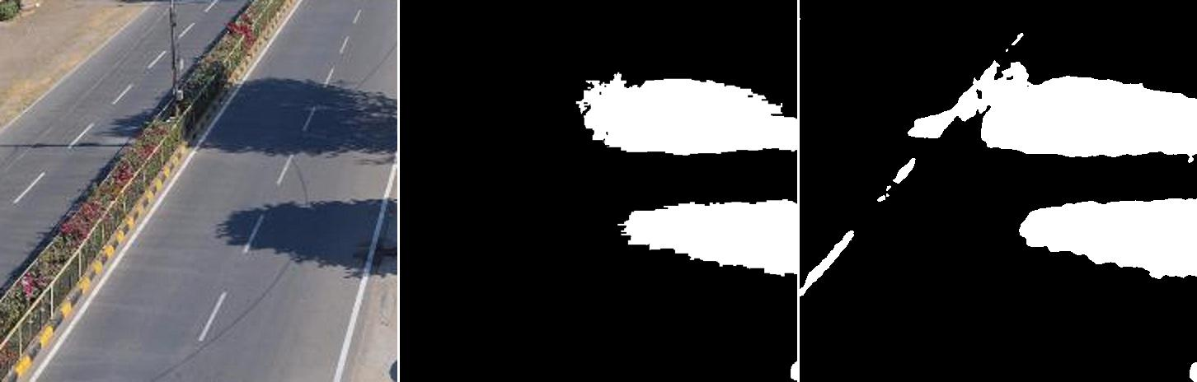
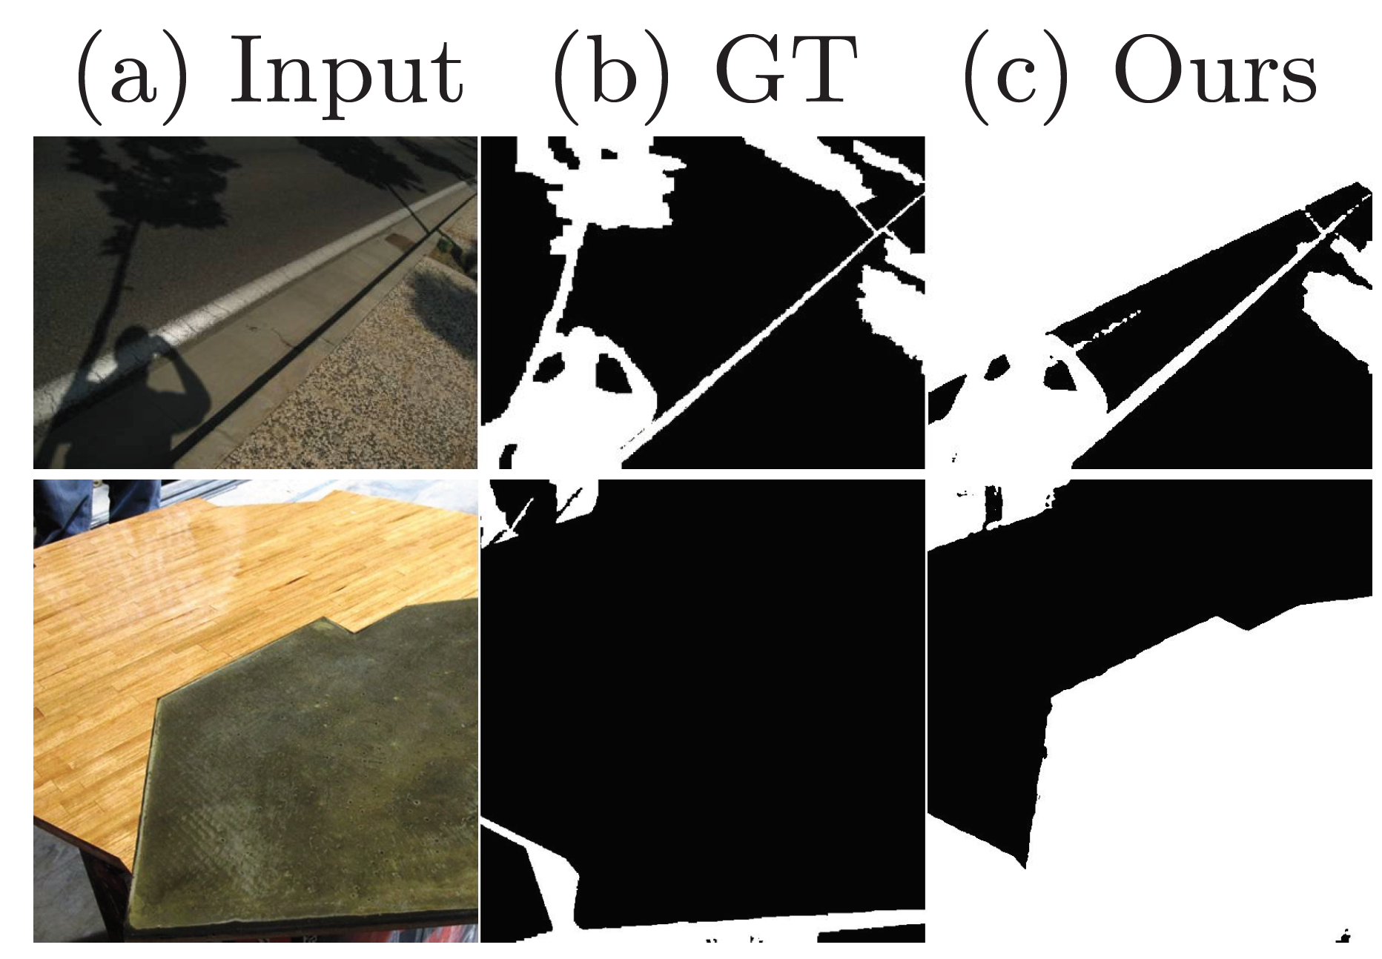
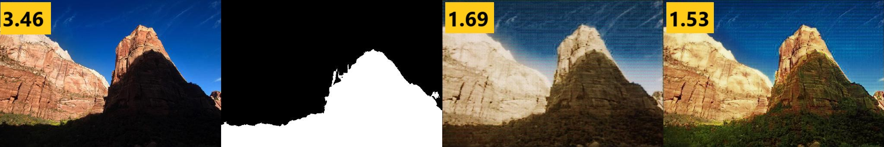
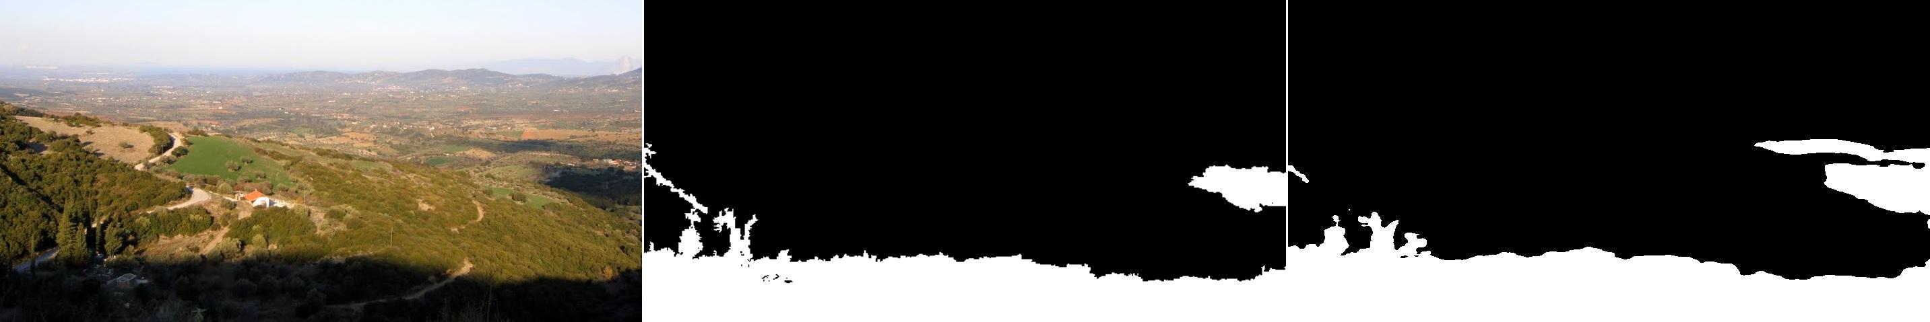
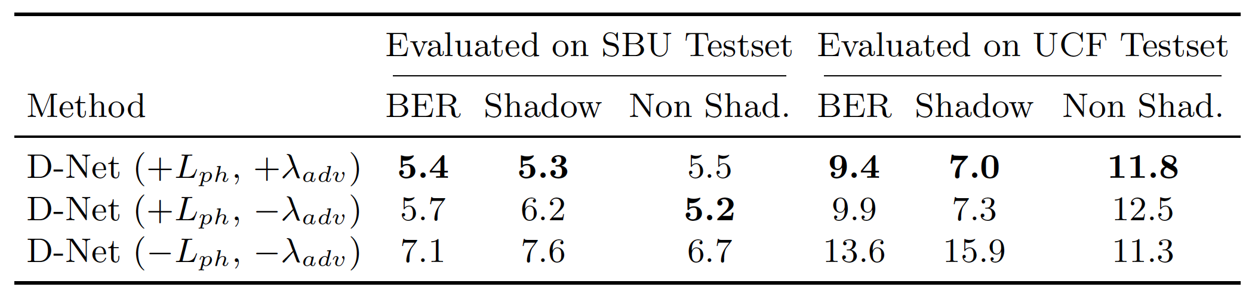
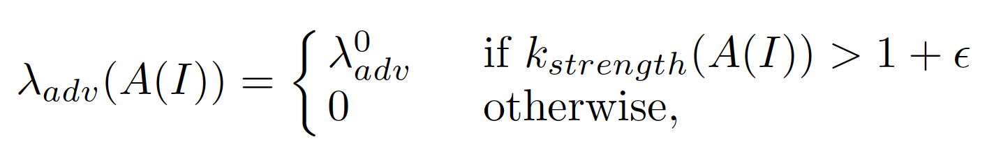
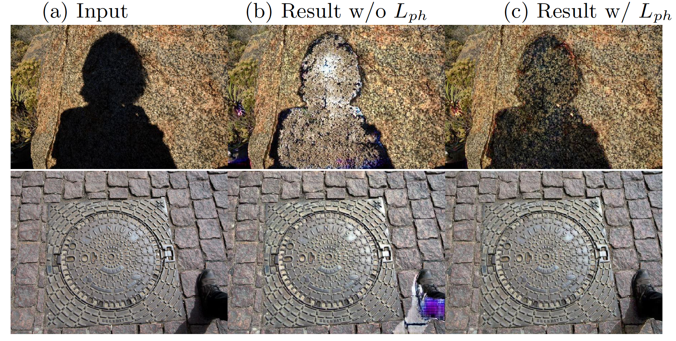
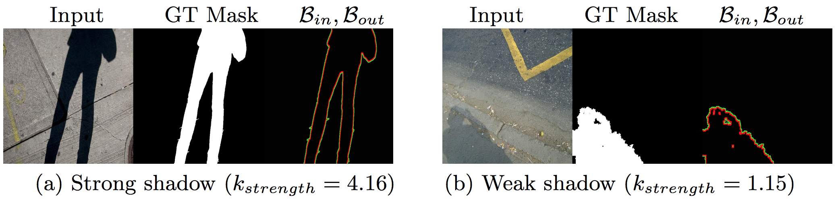
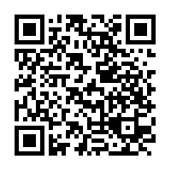
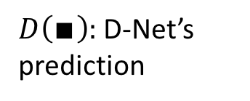

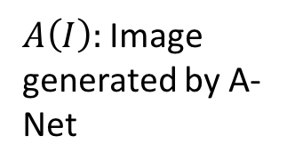
A+D Net: Training a Shadow Detector with
Adversarial Shadow Attenuation
Hieu Le , Tomas F. Yago Vicente, Vu Nguyen, Minh Hoai, and Dimitris Samaras
Department of Computer Science, Stony Brook University
Introduction
Framework
Results
We use a GAN-based framework for shadow detection.
A shadow detection network (D-Net) is trained together with a shadow attenuation network (A-Net):
  A-Net generates hard-samples to train D-Net by attenuating the shadow regions in the input image, following a physics-inspired illumination constraint.
  D-Net learns to detect shadow pixels from the original images and the images generated by A-Net.
A-Net is trained to re-illuminate only the shadow areas so that they cannot be detected by the detector network D-Net:
Inside the GT shadow mask:
  Shadow pixels are re-illuminated such that D-Net cannot recognize them as shadow pixels.
  The resulting pixel transformation obeys a physics-inspired illumination constraint [7], i.e., all pixels in the shadow area are multiplied by the same factor.
Outside the GT shadow mask:
  Values of non-shadow pixels are preserved.
A-Net
D-Net
Failure cases:
Highlights:
  Increasing resilience to adversarial examples improves overall shadow detection performance.
  With the physics-inspired illumination constraint, A-Net generates examples that are more beneficial for training D-Net.
  A simple physical illumination model can be used to estimate the probability of having label noise.
  Our method obtains state-of-the-art shadow detection results at real-time detection speed.
input
GT
Epoch 1
Epoch 5
Ablation study:
D-Net learns to detect shadows from real and adversarial samples:
$I:$ Input image
Loss on the
real samples
Loss on the adversarial samples
$A\left(I\right):$ Image generated by A-Net
estimates if A(I) is a shadow-free image
$D\left(∎\right):$ D-Net’s prediction
References
[7]. Guo, R., Dai, Q., Hoiem, D.: Single-image shadow detection and removal using paired regions. In: CVPR 2011
[10]. Hu, X., Zhu, L., Fu, C.W., Qin, J., Heng, P.A.: Direction-aware spatial context features for shadow detection. In: CVPR 2018
[20]. Nguyen, V., Vicente, T.F.Y., Zhao, M., Hoai, M., Samaras, D.: Shadow detection with conditional generative adversarial networks. In: ICCV 2017
[30]. Vicente, T.F.Y., Hou, L., Yu, C.P., Hoai, M., Samaras, D.: Large-scale training of shadow detectors with noisily-annotated shadow examples. In: ECCV2016
[32]. Wang, J., Li, X., Yang, J.: Stacked conditional generative adversarial networks for jointly learning shadow detection and shadow removal. In: CVPR 2018
[36]. Zhu, J., Samuel, K., Masood, S., Tappen, M.: Learning to recognize shadows in monochromatic natural images. In: CVPR 2010
Acknowledgements. This work was supported by the Vietnam Education Foundation, a gift from Adobe, NSF grant CNS-1718014, the Partner University Fund, and the SUNY2020 Infrastructure Transportation Security Center. The authors would also like to thank NVIDIA for GPU donation.
Live demo

